Slide 1
FRUITS IMPORT AND EXPORT
PRESENTED BY
R.Babinpratheeve
20BCA112
UNDER THE GUIDANCE OF
MRS. S.Sarmila.MCA, ME(CSE)

Slide 2
ABSTRACT
This project is developed for my own Fruit’s Export and Import company.
This project includes ―buying and ordering fruits through online.
In this single website the user can buy their fruits on seeing the availability of what fruit they needed, user can easily select the variety of fruit based on the quality.
And finally they can even calculate the total purchase of their products.

Slide 3
EXISTING SYSTEM
In the existing system, the customers ordered their products without seeing the availability of the fruits.
This will leads to disappointment for the customers about their orders.
The customer expectations about their varieties of the fruits.

Slide 4
PROPOSED SYSTEM
In the proposed system, the customers can order their products by seeing the availability of the fruits.
This makes the customers more comfortable and satisfies their needs of varieties what they want.
I included the location with the directions and also I added the address of the shop for the customer verification.

Slide 5
HARDWARE CONFIGURATION
Processor : AMD A4-9120e RADEON R3, 4 COMPUTE CORES 2C +2G 1.50 GHz
RAM : 4 GB Hard Disk
Drive : 1 TB
Mother board : Intel core i5 mother
board Mouse : Optical mouse

Slide 6
SOFTWARE CONFIGURATION
Operating System : Windows 10
Front End : HTML CSS
Back End : PHP
Database : My SQL

Slide 7
MODULES
Order booking
Admin
- stock updates
- employee management
Product availability
Pre booking
Payment
Contact
About us

Slide 8
MODULES DESCRIPTION
Order booking:
This module allow you to order the fruits based on their varieties and your needs.
Here we collect your personal details for maintain our data.
Admin:
In this administrative login the admin can view and update the stock update and the less availability of the fruits.
An alert message will show the fruit will not available for tomorrow’s selling, that need to be ordered now and also admin can manage the staff details.
Product availability:
This module shows the availability of the fruits, at present.
This help the customer to order, what they need and also it shows the quality and variety of each and every fruits.
The product availability will be update based on the product purchased by the customer.
This product availability will be updated everyday. This module is available only in our page.

Slide 9
Pre booking:
This module is used to the customers to pre book their needed fruits through online mode.
Payment:
This module is used to the customer can initialize the payment only after confirming the order.
Your payment is available only through online transaction by the help of RAZOR PAY.
Contact:
In this contact module I include the inbuilt location service. It will direct you easily to our shop location. The location is directed by the google map service or else a link also available to locate our shop via google map.
About us:
In this module it shows about our website details and our products.
There everyone can easily see the overall details of our webpage.

Slide 10
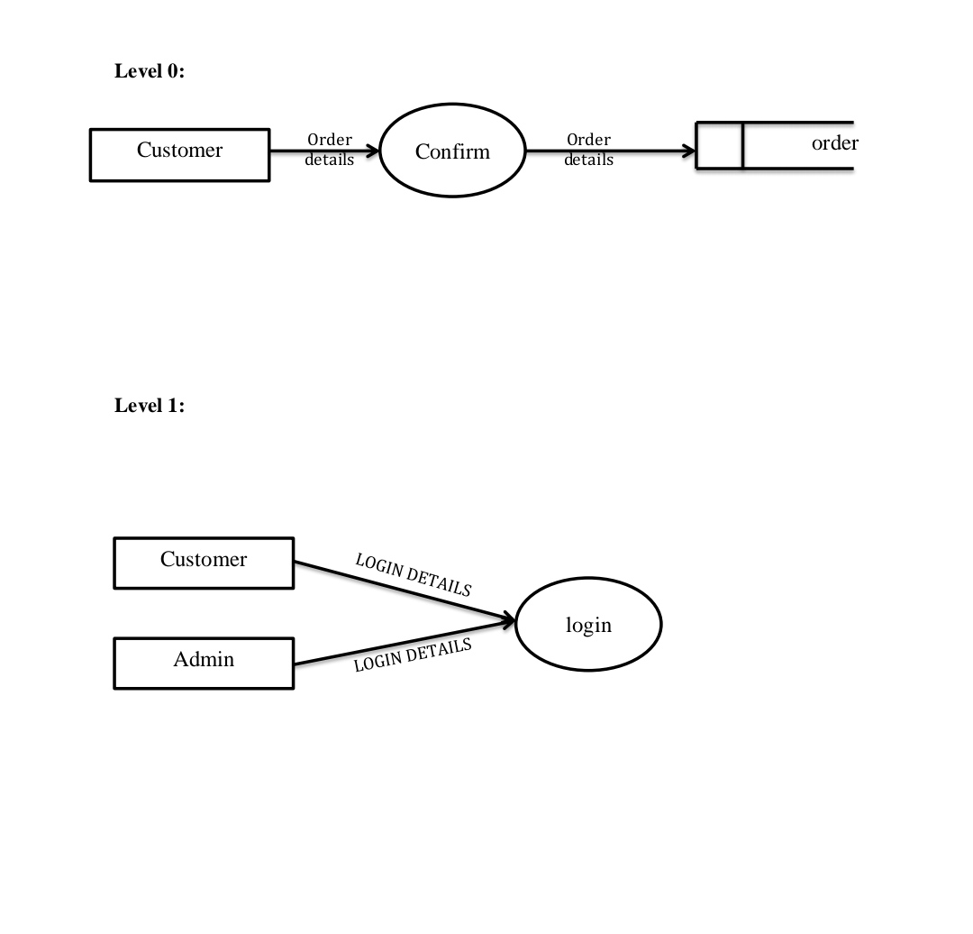
DATA FLOW DIAGRAM

Slide 11
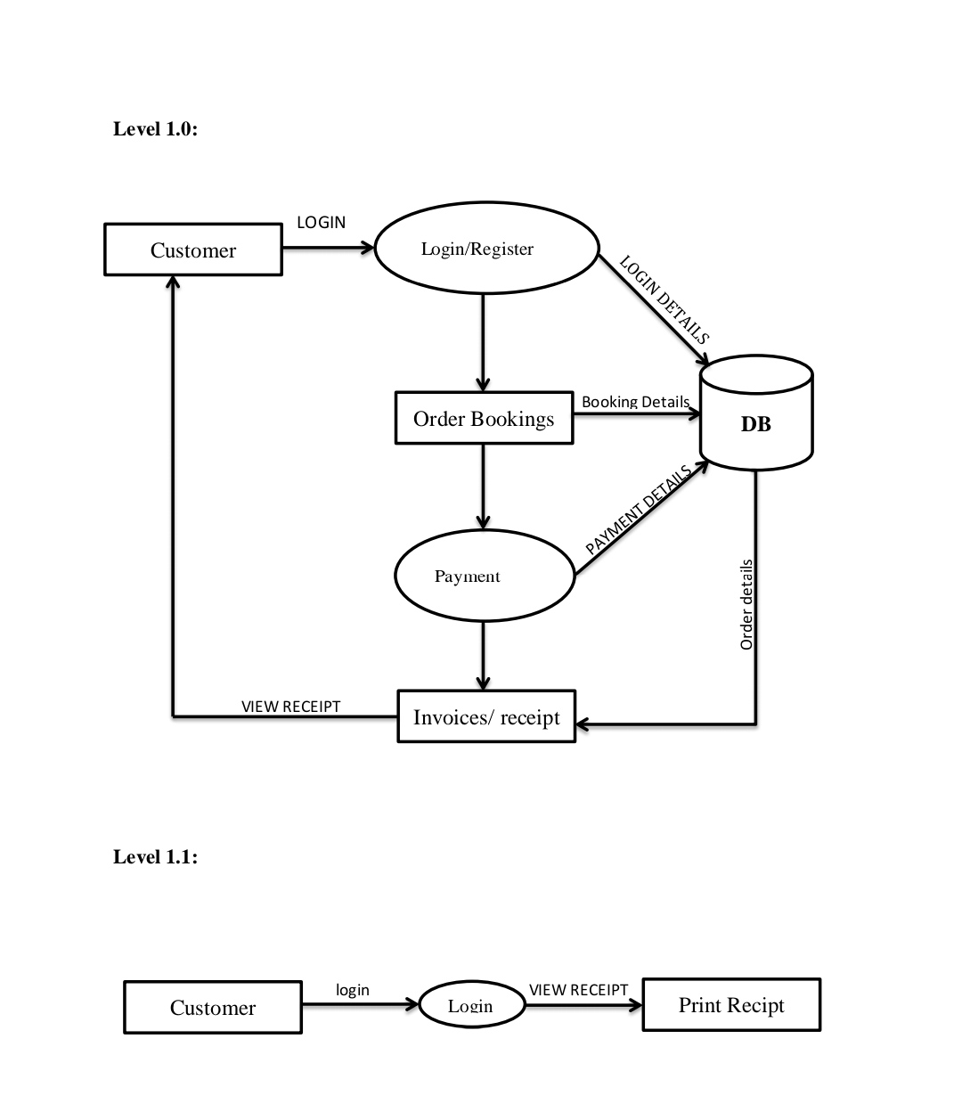
DATA FLOW DIAGRAM

Slide 12
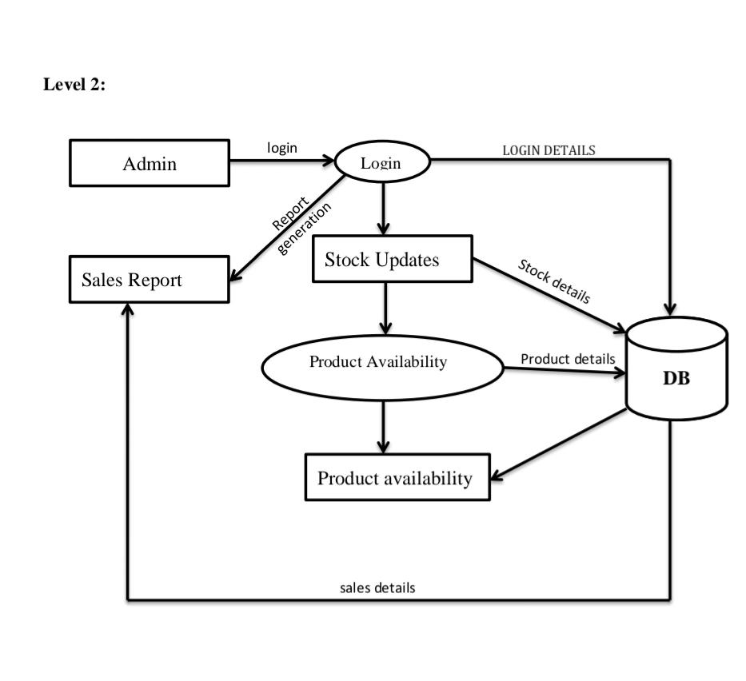
DATA FLOW DIAGRAM

Slide 13
DATABASE DESIGN
Customer details
FIELD NAME | DATA TYPE | SIZE | CONSTRAINTS
Customer name | char | 30 | Not null
Customer no | integer | 10 | Primary key
Customer ID | char | 45 | Not null
Address | varchar | 50 | Not null

Slide 14
Product details
FIELD NAME | DATA TYPE | SIZE | CONSTRAINT
Product | char | 25 | Not null
Variety | varchar | 30 | Not null
Quantity | integer | 15 | Not null
Booking
FIELD NAME | DATA TYPE | SIZE | CONSTRAINTS
Name | char | 30 | Not null
Address | varchar | 150 | Not null
Phone number | integer | 10 | Primary key
Due date | date |  | Not null

Slide 15
Sales report
FIELD NAME | DATA TYPE | SIZE | CONSTRAINTS
Product | char | 30 | Not null
Total_Purchase | integer | 20 | Not null
Total_sales | integer | 20 | Not null
Stock | integer | 20 | Not null
Stock details
FIELD NAME | DATA TYPE | SIZE | CONSTRAINTS
Product | char | 30 | Not null
Type | varchar | 25 | Not null
Quantity | integer | 30 | Not null
Date | date |  | Not null

Slide 16
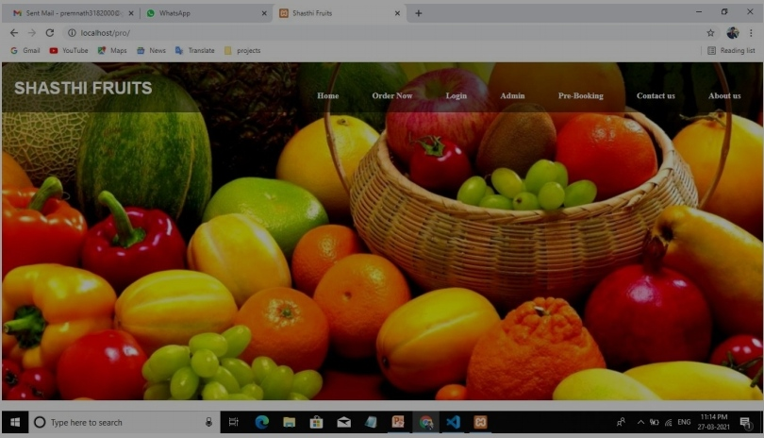
USER INTERFACE DESIGN

Slide 17
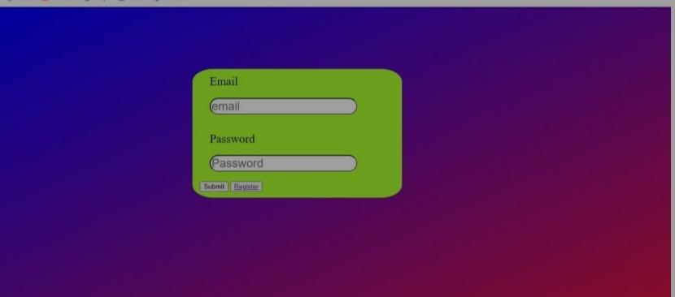
Login page:

Slide 18


Slide 19
THANK YOU !

